Slide 1




CAPSTONE PROJECT
Learning Management System
By,
BhanuPrakash Seetha 1033319
Pradeep Lakkineni 1033349
SaiKumar Puramvar 1033312
Neha KM 1033322
Mytrika Nari 1033334

Slide 2
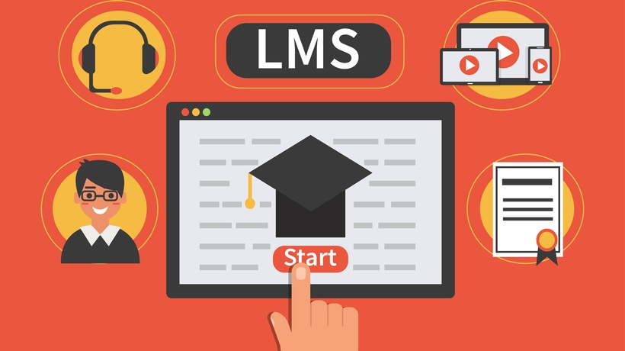
INTRODUCTION
Learning Management System (LMS) is a comprehensive platform designed to facilitate the delivery, management, and tracking of educational content in a digital environment. Its primary purpose is to streamline the learning process, providing educators, administrators, and learners with a centralized and efficient toolset.

Slide 3
INTRODUCTION
In the dynamic landscape of education and training, Learning Management Systems (LMS) have emerged as pivotal tools, transforming traditional learning methodologies into interactive and technology-driven experiences. This introduction provides an overview of an LMS developed using modern technologies,
React for the frontend,
Spring Boot for the backend, and
MySQL as the database.

Slide 4
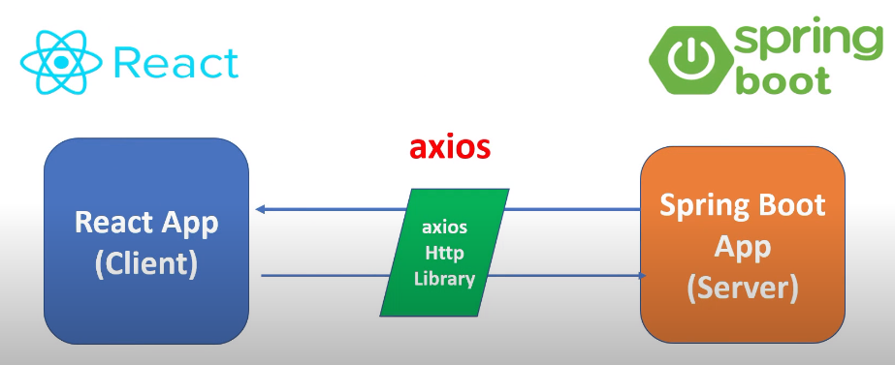
INTRODUCTION

Slide 5

AIM OF THE PROJECT
The aim of the project is to develop a responsive Learning Management System (LMS) using React, Spring Boot, and MySQL, enhancing the learning experience with efficient course management, dynamic assessment, and collaborative features.

Slide 6
OBJECTIVES
Following objectives are considered for project work implementation:
To create frontend with react using visual studio code tool .
To create backend by layered architecture using eclipse tool.
To create database using MySQL database.
To connect backend and frontend using axios.

Slide 7
REQUIREMENTS
Tools required:
Eclipse-->Backend
Visual Studio-->Frontend
MySQL for database
Software Requirements:
Operating System – Windows
Springboot Framework
Web Server - Tomcat

Slide 8
METHODOLOGY
In our project, we'll initiate the development of a Learning Management System (LMS) by setting up dedicated projects for the backend using Spring Boot and the frontend using React. We'll configure MySQL as our chosen database and design a suitable schema for storing crucial entities like courses, users, webinars, E-Books. The backend will involve creating controllers, services, and a repository. The integration of Spring Data JPA will facilitate seamless interactions with our MySQL database.
Moving to the frontend, we'll construct React components to represent different LMS features, implement routing for smooth navigation. User authentication will be a priority, and we'll implement features like registration and login. Course management functionalities, user profiles, survey management, progress tracking will be developed to provide a comprehensive learning experience.

Slide 9
METHODOLOGY
Thorough testing, both for the backend and frontend, will ensure the reliability of our system. The integration of these components will be executed meticulously, and the deployment process will involve placing the backend on a tomcat server and the frontend on visual studio code. Throughout development, we'll prioritize monitoring, scalability considerations, and maintain comprehensive documentation to aid future development and maintenance. Adherence to best practices and coding standards will be fundamental to ensure the robustness and longevity of our LMS.

Slide 10
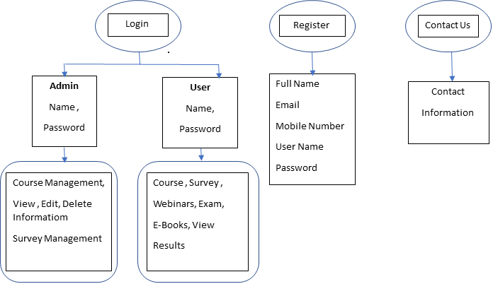
ER DIAGRAM

Slide 11
CONCLUSION
In conclusion, the developed Learning Management System (LMS) utilizing React, Spring Boot, and MySQL represents a significant leap forward in creating a modern and adaptable educational platform. The seamless integration of frontend and backend technologies, coupled with a robust database system, establishes a foundation for a responsive, user-friendly, and feature-rich learning environment.

Slide 12
FUTURE SCOPE
The future scope for the Learning Management System (LMS) developed with React, Spring Boot, and MySQL is poised for significant advancements in the realm of educational technology.
As technology continues to evolve, there are numerous opportunities for the LMS to further enhance its capabilities.
Integration of artificial intelligence and machine learning holds the potential for personalized learning experiences, adaptive content delivery, and intelligent analytics, catering to individual learner needs.

Slide 13
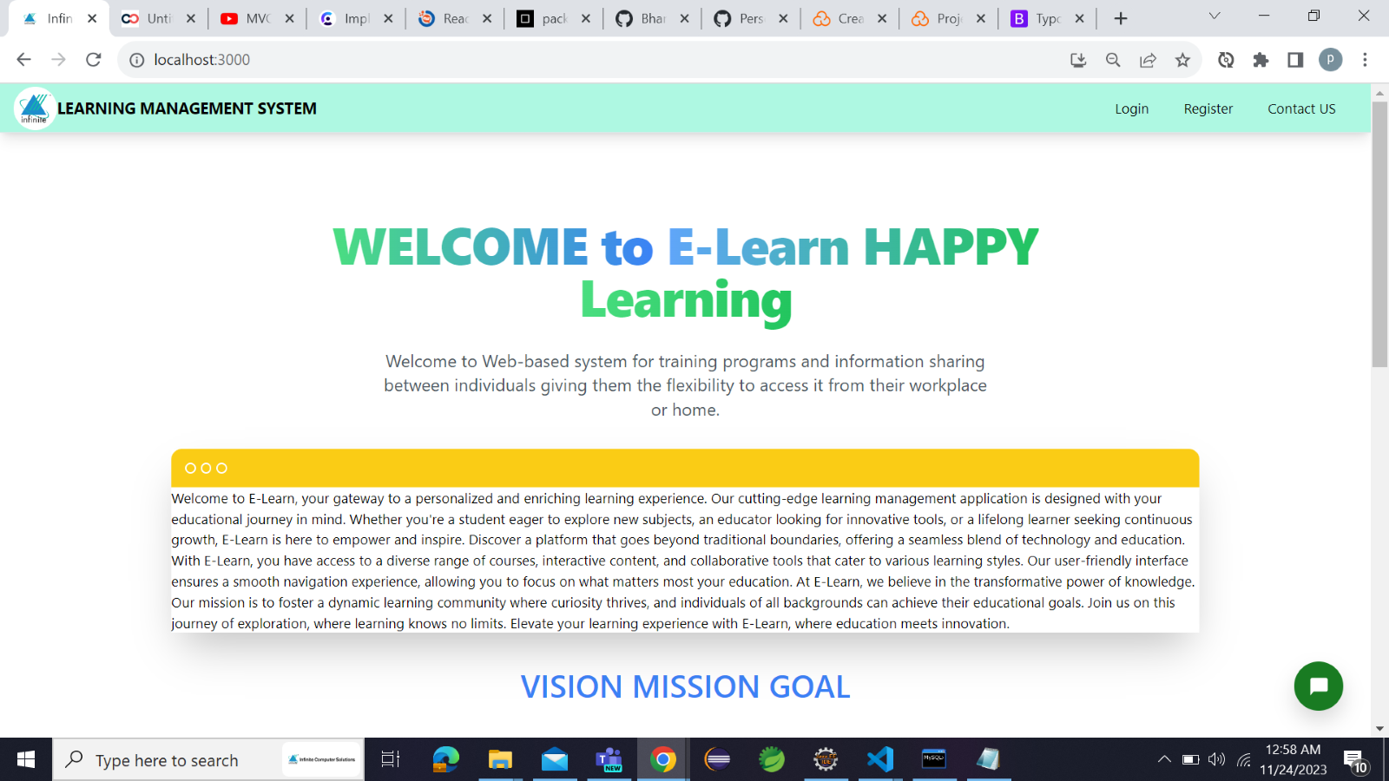
RESULTS AND DISCUSSION
1. Welcome Page:

Slide 14
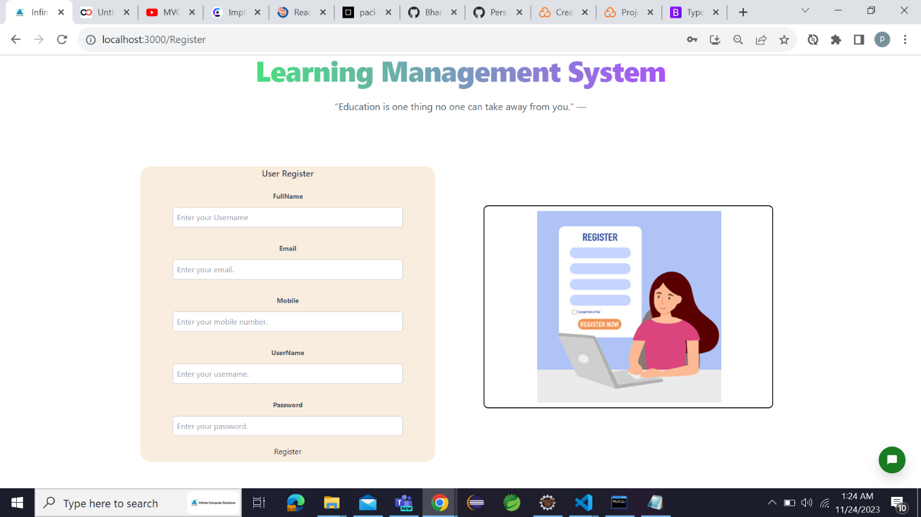
2.Registration Page:

Slide 15
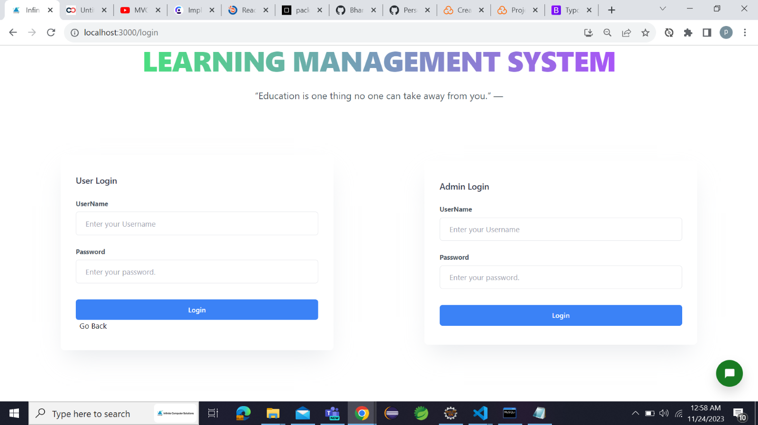
3. Login Page

Slide 16
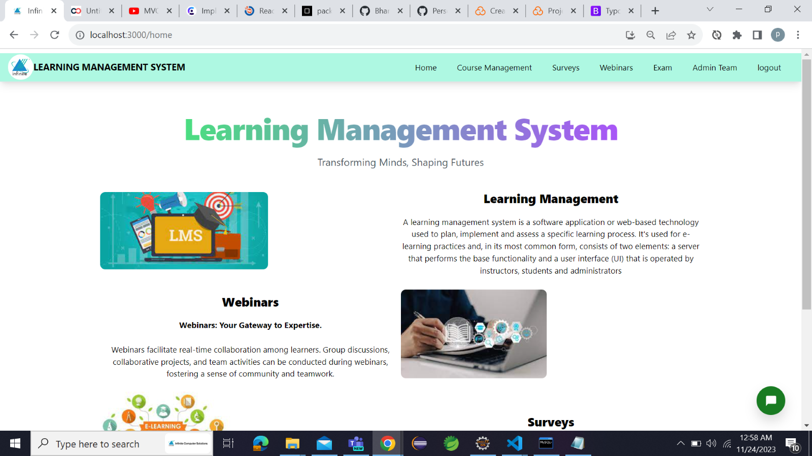
4. Landing Page after logging

Slide 17
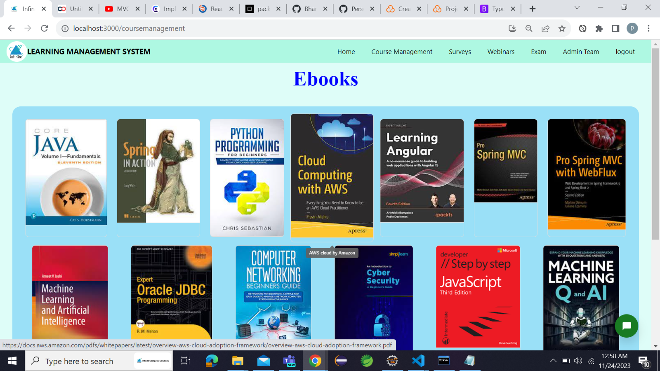
5. E-Books (Course Management):

Slide 18
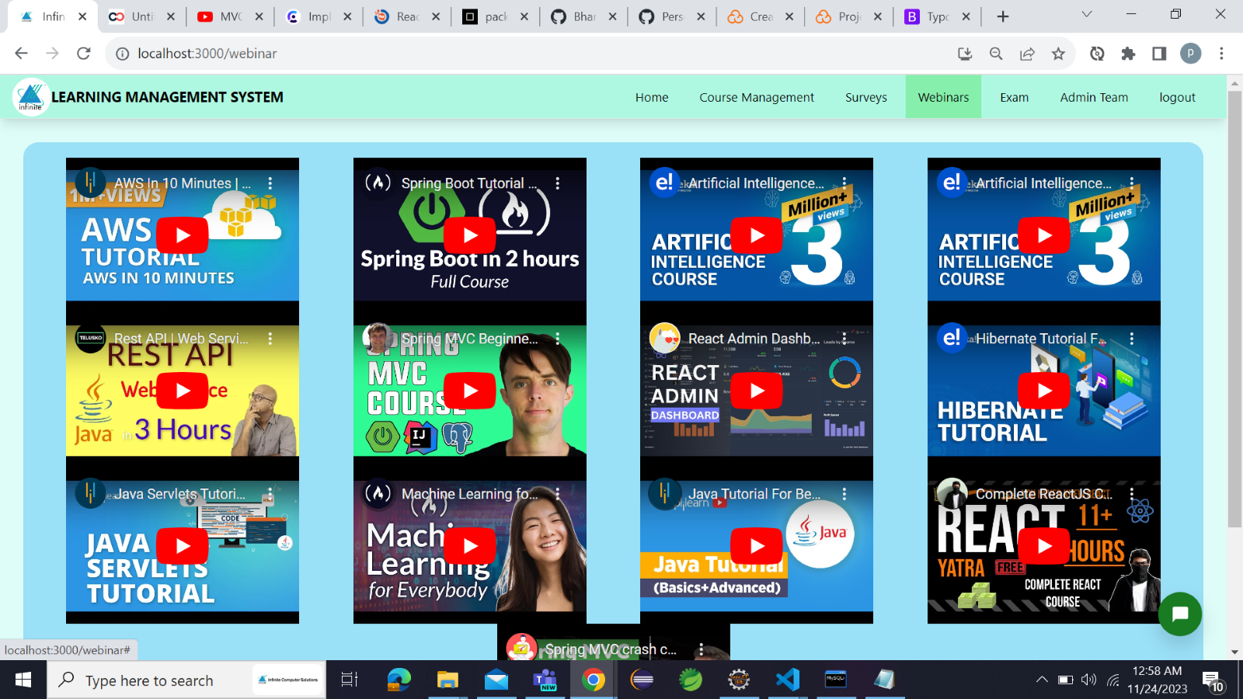
6. Webinar (Videos) page:

Slide 19
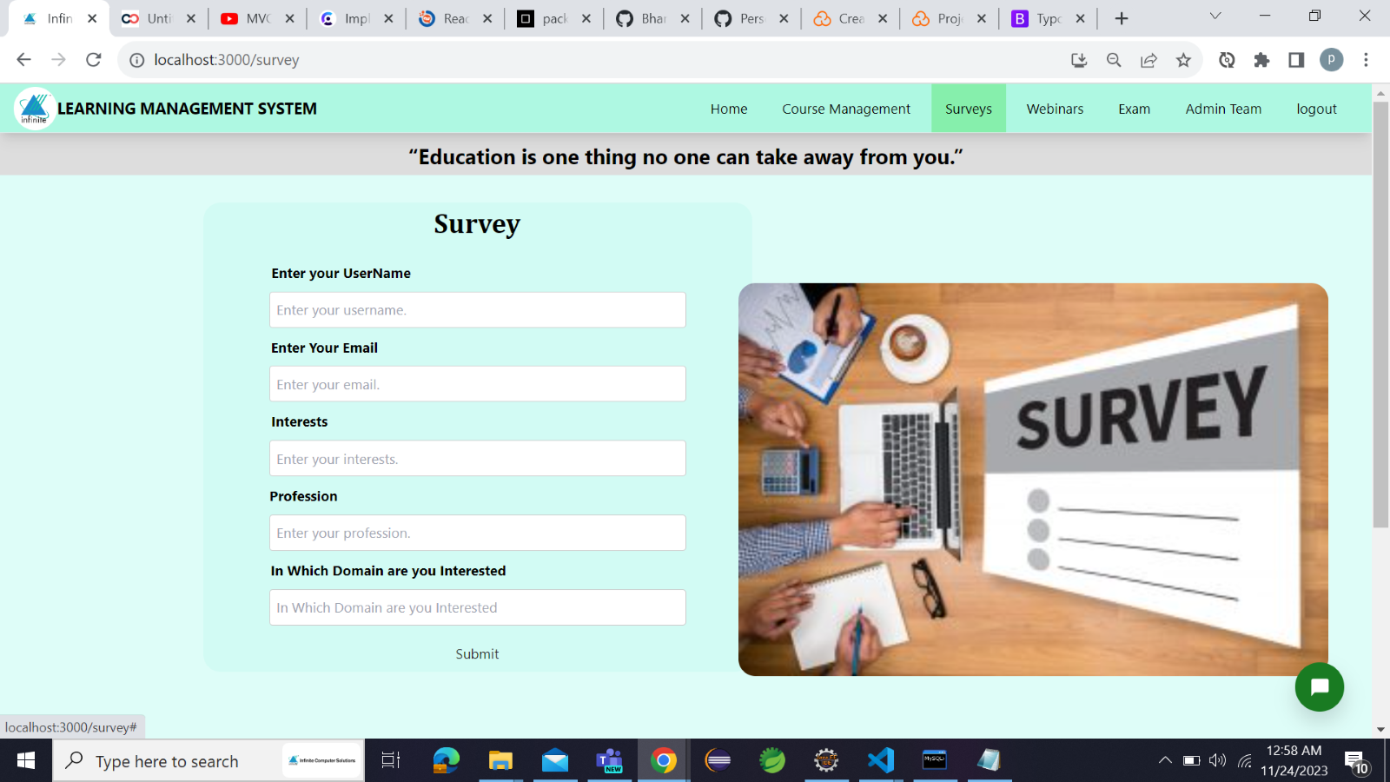
7. Survey:

Slide 20
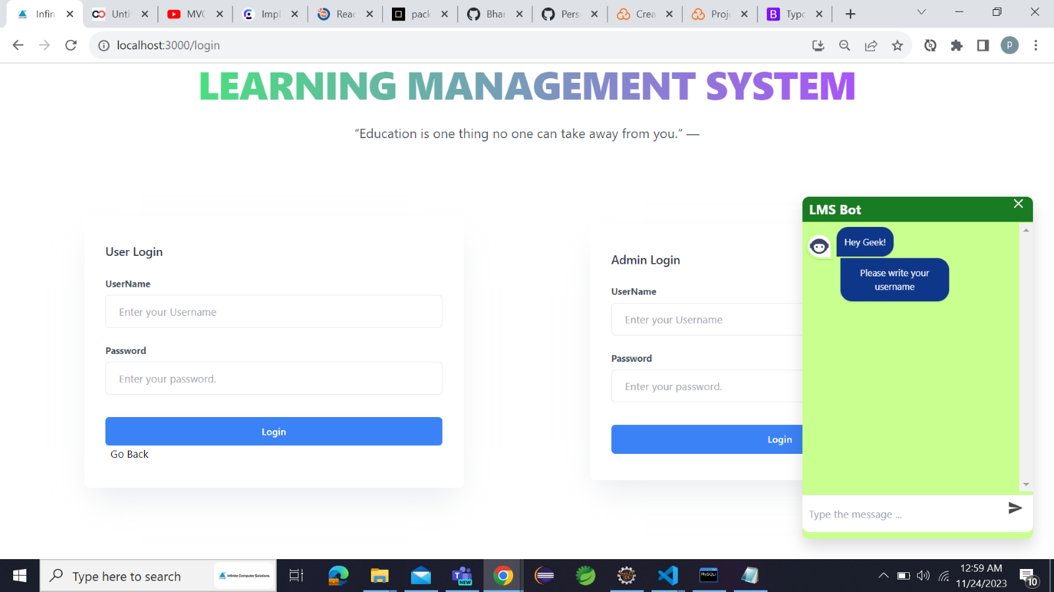
8. Active Chatbot:

Slide 21
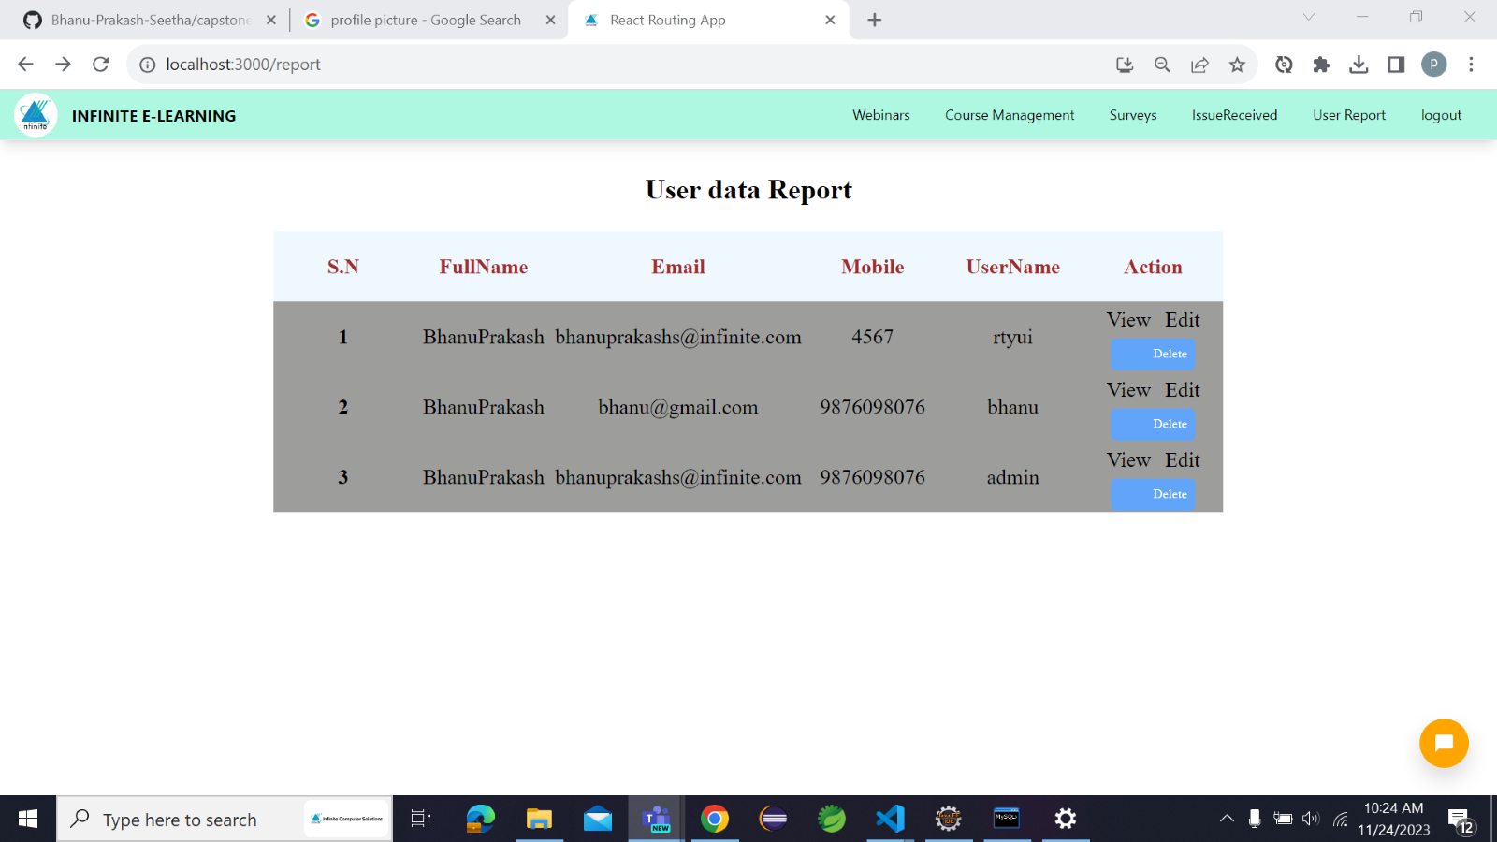
9. Report Page:

Slide 22
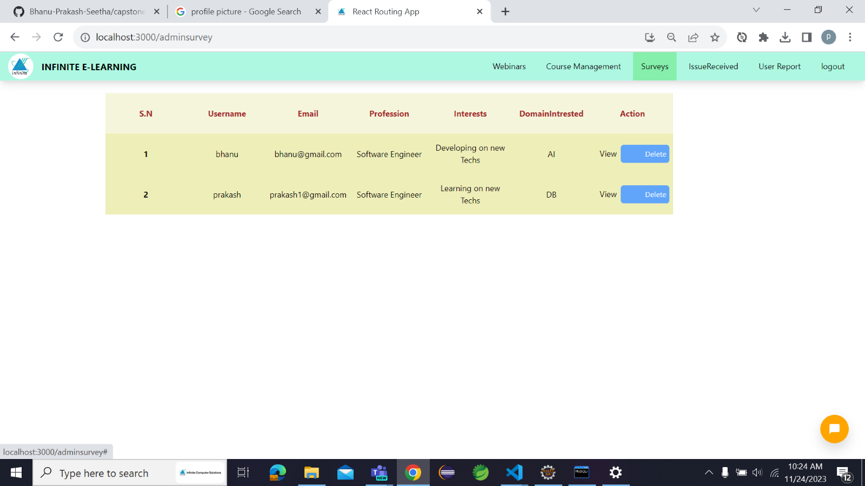
10. Admin Survey Page

Slide 23
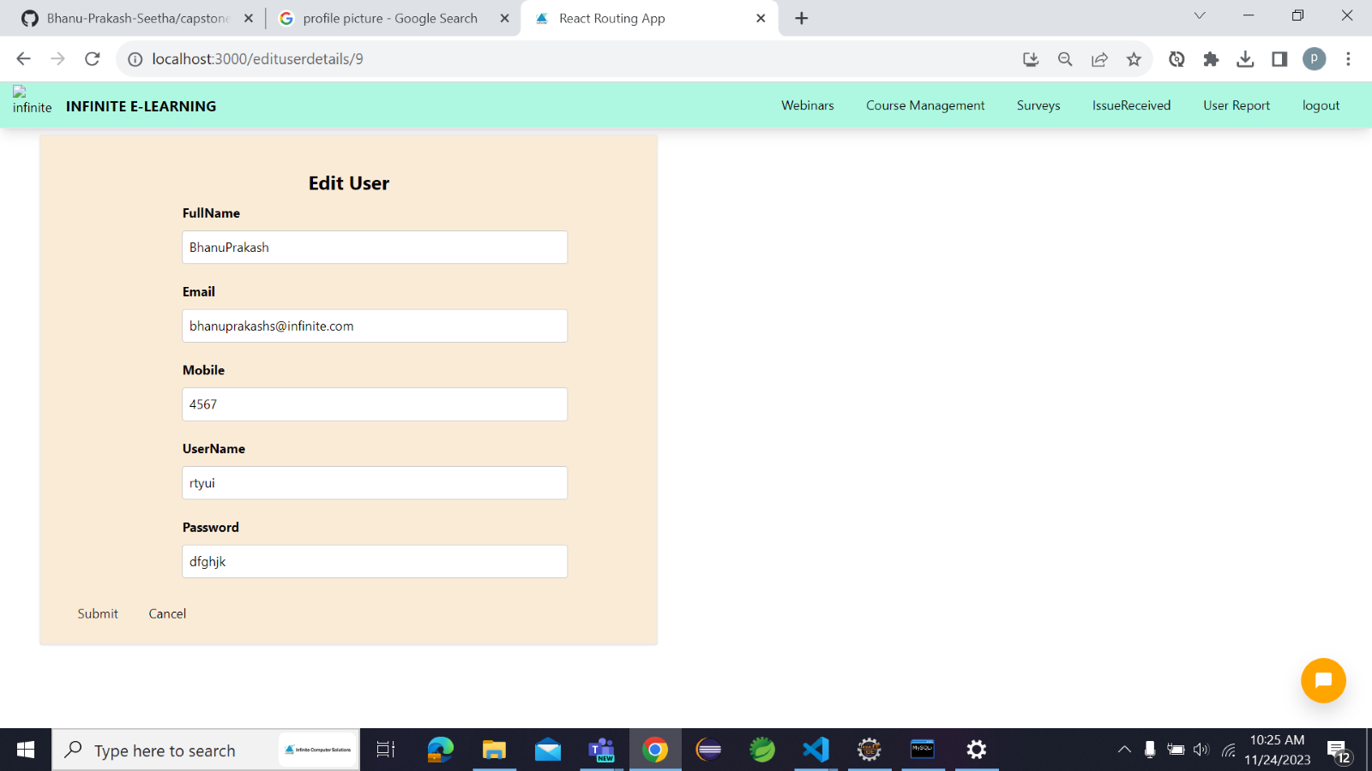
11. User Editing Page:

Slide 24


